Slide 1
Mohammad Ali Javidian Hypergraph & Bayesian Network Seminar 10/06/2017

Slide 2
Chain graph models and their causal interpretations
Steffen L. Lauritzen
University of Copenhagen, Denmark
and Thomas S. Richardson
University of Washington, Seattle, USA

Slide 3
Overview
Chain Graphs, basic definitions, concepts and notation
Basic factorizations in DAGs, undirected graphs, and chain graphs
Separation and D-Separation
The global Markov property and Markov equivalence
Rationale for chain graphs and their misuse
Data-generating processes for DAGs (Gibbs sampling)
Feed-back models for chain graphs
Intervention in undirected graphs, DAGs, and chain graphs

Slide 4
Basic graphical concepts and notation
A partially directed cycle in a graph G is a sequence of n distinct vertices $v_{1 },v_{2},…,v_{n} (n≥3)$, and $v_{n+1}≡v_{1}$ , such that at least one edge in it is directed.
uxyvu ✗
uzvu ✓
A chain graph is a graph in which there are no partially directed cycles.
x
y
z
u
v
x
y
x
y
x
y
z
z
z
u
v
u
v
u
v

Slide 5
Basic graphical concepts and notation
A subset C of vertices is complete if there is an edge (directed or undirected) between every pair of vertices in C. A maximal complete subset is a clique.
If $u→v$, the vertex u is a parent of v and, if $u−v$, u is a neighbor of v. The set of parents of v is denoted pa(v) and the set of neighbors is denoted ne(v). The set $bd\left(v\right)=pa(v)∪ne(v)$ is the boundary of v. For a subset $A⊆V$, we let
$$pa\left(A\right)=∪_{v∈A}pa\left(v\right)\backslash A.$$
A minimal complex in a chain graph is an induced subgraph of the form $a→u−…−v←b.$
pa(x) ={u}, ne(x)={z}, bd(x)={u , z}
pa({x,y,z})={u,v}
$u→x−z−y←v$
x
z
y
u
v

Slide 6
The chain components τ of a chain graph are the connected components of the undirected graph obtained by removing all directed edges from the chain graph.
Theorem (The chain rule for Bayesian networks). Let BN be a Bayesian network over U = {$x_{1}, x_{2}, …, x_{n}$}. Then BN specifies a unique joint probability distribution P(U) given by the product of all conditional probability tables specified in BN: $p\left(U\right)=\prod_{i=1}^{n}{p(x_{i}|pa(x_{i}))}$.
Example:
p(x,y,u,v,z)=p(u|x)p(v|y)p(z|x,y)p(x)p(y)
x
z
y
x
z
y
$$v_{3}$$
u
v
u
$$v_{2}$$
v
$$v_{1}$$
x
y
z
u
v
Factorizations in DAGs

Slide 7
Factorizations in undirected graphs
(Joint probability distribution (JPD) factorized according to an undirected graph) A JPD p(x) is said to factorize according to an undirected graph G if it can be written as
$$p\left(x\right)=\prod_{c∈C}{φ_{c}\left(x\right),}$$
where $φ_{c}$, are nonnegative functions; and $C$denotes the set of cliques of G.
Example:
$$p\left(x\right)=φ_{1}(x,y)φ_{2}(x,u)φ_{3}(v,y)φ_{4}(u,v,z)$$
x
y
z
u
v

Slide 8
Moral graph of a chain graph: For a chain graph G we define its moral graph $G^{m}$ as the undirected graph with the same vertex set, and new undirected edges added as follows: α and β are adjacent in $G^{m}$ if either $α→β$ or $β→α$ or if there are $γ_{1},γ_{2}$ in the same chain component such that $α→γ_{1}$and $β→γ_{2}$.
Example:
x
z
y
x
z
y
$$v_{3}$$
u
v
u
v
$$v_{2}$$
$$v_{1}$$
G
$$G^{m}$$
Factorization in Chain graphs

Slide 9
Factorization in Chain graphs
The factorization in the case of a chain graph involves two steps:
We first assume a factorization of the density as in the directed acyclic case:
$f\left(x\right)=\prod_{τ∈T}{{f(x}_{τ}\left|x_{pa\left(τ\right)}\right),}$ (◙)
where T is the set of chain components of the graph G.
The factors in (◙) can be further factorized as
$${f(x}_{τ}\left|x_{pa\left(τ\right)}\right)=Z^{−1}(x_{pa\left(τ\right)})\prod_{c∈C}{φ_{c}(x_{c})}$$
where C are the complete sets in the moral graph ${(τ∪pa\left(τ\right))}^{m}$. The factor Z is a normalizer
$$Z\left(x_{pa\left(τ\right)}\right)=\sum_{x_{τ}}{\prod_{c∈C}{φ_{c}\left(x_{c}\right).}}$$

Slide 10
Example:
$f\left(u,v,x,y,z\right)=f_{1}(v)f_{2}(u)f_{3}(x,y,z|u,v)$
$f\left(u,v,x,y,z\right)=φ_{v_{1}}(v)φ_{v_{2}}(u)φ_{v_{3}}^{uv}(u,v)φ_{v_{3}}^{ux}(u,x)$ $φ_{v_{3}}^{vy}(v,y)$ $φ_{v_{3}}^{xz}(x,z)$ $φ_{v_{3}}^{zy}(z,y)$
, where $Z^{−1}\left(u,v\right)={(φ_{v_{3}}^{uv}(u,v))}^{−1}=\sum_{x,y,z}{φ_{v_{3}}^{ux}(u,x) φ_{v_{3}}^{vy}(v,y) φ_{v_{3}}^{xz}(x,z) φ_{v_{3}}^{zy}(z,y)}$
x
z
y
x
z
y
$$v_{3}$$
Step 1
u
v
u
v
$$v_{2}$$
$$v_{1}$$
x
z
y
$$v_{3}$$
x
z
y
Step 2
u
v
u
v
$$v_{2}$$
$$v_{1}$$
$$G^{m}$$
Factorization in Chain graphs

Slide 11
Separation and D-Separation
A subset $C⊆V$ is said to be an (α, β)-separator if all paths from α to β intersect C.
The subset С is said to separate A from В if it is an (α, β)- separator for every $α∈A, β∈B$.
Example: {y} separates {u,x} and {v}.
{x} does not separate {u} and {v,y}
Let G=(V,E) be a DAG:
Diverging connection (tail-to-tail):
Converging connection (head-to-head):
Serial connection (head-to-tail):
x
y
u
v
z
x
y
x
y
z
x
y
z

Slide 12
Definition (d-separation). Two distinct variables A and B in a causal network are d-separated (“d” for “directed graph”) if for all paths between A and B, there is an intermediate variable V (distinct from A and B) such that either
− the connection is serial or diverging and V is instantiated
or
− the connection is converging, and neither V nor any of V ’s descendants have received evidence.
z
z
e
x
y
x
y
x
y
x
y
z
z
e
D-connected
D-separated
D-connected
D-separated
x
y
x
y
x
y
z
z
e
z
D-separated
D-connected
u
v
e
Separation and D-Separation

Slide 13
Global Markov property in undirected graphs
The global Markov property allows a simple translation from a graph-theoretic property, separation, to a statistical property, conditional independence.
Consider three random variables, X, Y, and Z. If, for each value z, X and Y are independent in the conditional distribution given Z = z, then we say that X and Y are conditionally independent given Z, and we write this as $X⫫Y|Z$.
The global Markov property for undirected graphs states: If two sets of variables X and Y are separated by a third set of variables Z, then 𝑋⫫𝑌|𝑍.
$$\text{x}\text{⫫}\text{v}\text{|}\text{y}\text{ ,}\text{x}\text{⫫}\text{v}\text{|}\text{(}\text{y}\text{,}\text{u}\text{),}\text{u}\text{⫫}\text{v}\text{|}\text{y}\text{,}\text{u}\text{⫫}\text{v}\text{|}\text{(}\text{x}\text{,}\text{y}\text{)}$$
x
y
u
v

Slide 14
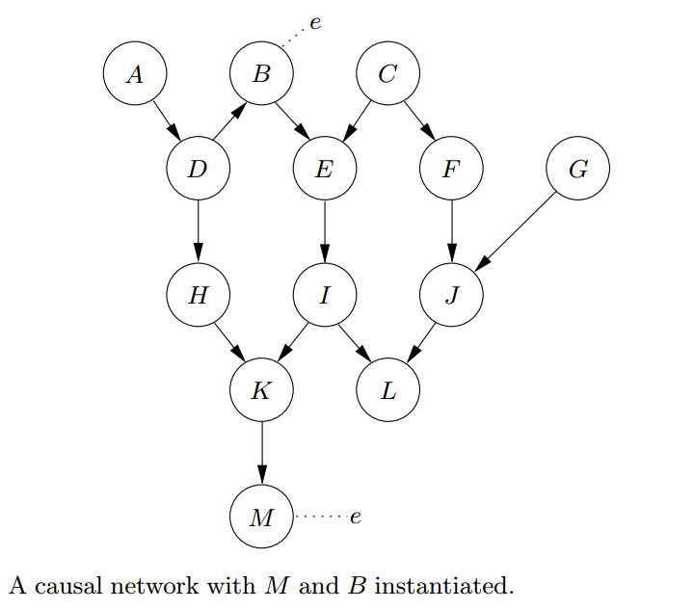
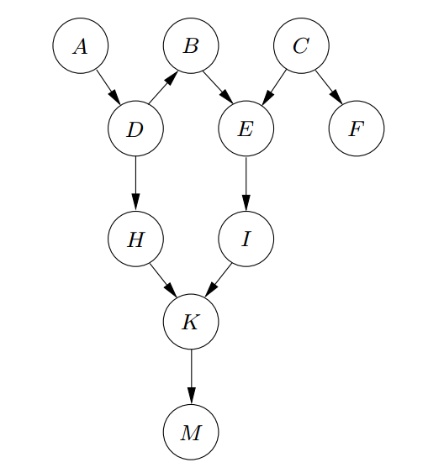
Definition (Ancestral set). Let $S⊆V.$ If there is a path from v to w, then v is called an ancestor of w. The set of ancestors of nodes in S is denoted 𝑎𝑛(𝑆), and ${an}^{+}\left(S\right)=S∪an(S)$ is called the ancestral set of S.
ancestral graph for {A, B, F, M}
Global Markov property in DAGs

Slide 15
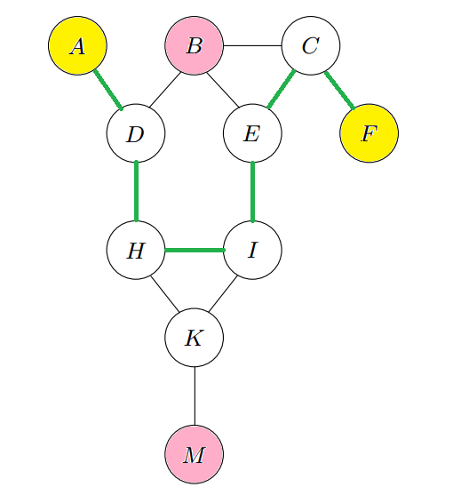
Global Markov property in DAGs
The global Markov property for DAGs states that for three disjoint sets $S_{1},S_{2}$, and $S_{3}$,$S_{1}⫫S_{2}|S_{3}$if $S_{3}$separates $S_{1}$ and $S_{2}$ in $G_{𝒜}^{m}$ where $𝒜={an}^{+}(S_{1}∪S_{2}∪S_{3})$.
moral graph of ${an}^{+}$({A, B, F, M})

Slide 16
The global chain Markov property, relative to G, if for any triple (А, В ,S) of disjoint subsets of V such that S separates A from В in $G_{𝒜}^{m}$ where $𝒜$is the smallest ancestral set containing $A∪B∪S$, we have $A⫫B|S$.
Example: Consider that $𝒜=V ,or \left\{a,b,c\right\}, or \left\{a,b,d\right\}, or \left\{b,c,d\right\}, or \{a,c,d\}$
Under the chain graph Markov property, graph G implies:
$a⫫b ,a⫫d|\left\{b,c\right\}, b⫫c|\{a,d\}$
c
d
c
d
a
b
a
b
G
$${\text{G} }_{𝒜}^{m}$$
Global Markov property in chain graphs

Slide 17
Markov equivalence
Two graphs are called Markov equivalent if they induce the same conditional independence restrictions.
Two chain graphs ${CG}_{1}$ and ${CG}_{2}$ are Markov equivalent if and only if they have the same adjacencies and the same minimal complexes.
Example:
c
d
c
d
c
d
a
b
a
b
a
b
G has one minimal complex: $c⟶d⟵b$
Markov equivalent with G
Is not Markov equivalent with G
Notes:
Need to change the third one! As it is, it is Markov equivalent!

Slide 18
Rationale for chain graphs and their misuse
Directed graphs with latent variables and selection variables
Example: Randomized Trial of an Ineffective Drug with Unpleasant Side-Effects
Notes:
Those patients who suffer sufficiently severe side-effects are likely to drop out of the study.
A simple comparison of the recovery time of the patients still in the treatment and control groups at the end of the study will indicate faster recovery among those in the treatment group.
This comparison falsely indicates that the drug has a beneficial effect, whereas in fact, this difference is due entirely to the side-effects causing the
sicker patients in the treatment group to drop out of the study.
Example from Thomas S. Richardson. “Chain Graphs and Symmetric Associations.” In: Michael Jordan (editor). Learning in Graphical Models. Kluwer Academic Publishers, 1998, pp. 231-259.

Slide 19
Rationale for chain graphs and their misuse
Under the chain graph Markov property, graph CG implies:
$a⫫b ,a⫫d|\left\{b,c\right\}, b⫫c|\{a,d\}$
Some possible reasons for using undirected edges in chain graphs to show non-causal associations:
When two nodes share an unmeasured common parent (latent variable)
c
d
a
b
CG
H
c
d
a
b

Slide 20
When two nodes share a common child that has been conditioned on (selection bias)
When variable A influences variable B, and at the same time, B influences A (Economic and physical processes are often modelled by linear systems of this sort; so-called non-recursive structural equation models)
S
c
d
a
b
c
d
a
b
Rationale for chain graphs and their misuse

Slide 21
Rationale for chain graphs and their misuse
In fact, there is no (finite) DAG model which, under marginalizing and conditioning, gives the set of conditional independence relations implied by graph CG in the previous example.
Chain graphs as unions of directed acyclic graph models
Proposition. Let $D_{1}$ and $D_{2}$ be two DAGs with the same adjacencies, such that $D_{1∪2}$ is a chain graph. Then ${M(D}_{1∪2})=M(D_{1})∪M(D_{2})$ if and only if $D_{1}$ and $D_{2}$ are Markov equivalent, i.e. when $M\left(D_{1}\right)=M(D_{2})$.
c
d
c
d
c
d
$$∪$$
?
=
a
b
a
b
a
b
Notes:
This was pointed out by Richardson (1998),who showed that all conditional independence structures which can be obtained by such marginalization and conditioning from a DAG satisfy a property of between separation(theorem 1 of Richardson (1998)), whereas graph CG3 does not.
These two DAGs are not Markov equivalent because they have different minimal complexes.
M(G) denote the set of distributions obeying the conditional independence relations associated with a graph G.

Slide 22
In Gibbs sampling, you start with some configuration consistent with the evidence and then you randomly change the state of the variables in topological order. In one sweep through the variables, you determine a new configuration, and then you use this configuration for a new sweep, and so on.
To apply the Gibbs sampler, we need to calculate for each node its distribution conditional upon all the other nodes. For this purpose we use the moral graph of the given DAG:
$p\left(x_{v} | x_{V\backslash \{v\}}\right)=p(x_{v}|x_{ne\left(v\right)∈G^{m}})$,
where $G^{m}$ is the moral graph of $G$.
Data-generating processes for DAGs (Gibbs sampling)
Notes:
Consider the evidence be B = n and E = n. Assume also that we are given the starting configuration ynyyn. Run the Hugin program.

Slide 23
Feed-back models for chain graphs
The data-generating processes for chain graph models have two loops:
Repeat until equilibrium:
The outer loop corresponds to the DAG of chain components
The inner loop, represented by $G_{τ}$, updates the variables in the chain component $τ$. For those components that are not singletons, $G_{τ}$ represents one of the generating processes for undirected graphs applied to a chain component $τ$ for a fixed value of the variables at its parents $x_{pa(τ)}$.
The expressions 'until equilibrium' means that the random assignments are repeated a very large number of times, so that a 'stochastic' equilibrium prevails.
The system involves feed-back in the sense that the value of $X_{i}$ for any $iεV$ has been dynamically affected by all the variables $X_{bd(i)}$.

Slide 24
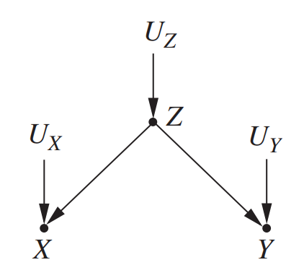
Conditioning by observation:
$$p\left(x | y\right)=p\left(x | Y=y\right)=\frac{p(x,y)}{p(y)}$$
Conditioning by intervention:
When we intervene on a variable in a model, we fix its value. We change the system, and the values of other variables often change as a result. When we condition on a variable, we change nothing. What changes, then, is our perception about the world, not the world itself.
Example: Following figures show a graphical model of ice cream sales example, with X as ice cream sales, Y as crime rates, and Z as temperature.
Intervention in undirected graphs, DAGs, and chain graphs
Notes:
A graphical model representing the relationship between temperature (Z), ice cream sales (X), and crime rates (Y)
If we were to intervene to make ice cream sales low (say, by shutting down all ice cream shops), we would have the graphical model shown in Figure 3.2.

Slide 25
Intervention in undirected graphs, DAGs, and chain graphs
To make the distinction clear we use different symbol for the conditioning by intervention:
$p(x|\left|y\right)=p\left(x | Y←y\right)=p(x|do(Y=y))$.
Generally, the two quantities will be different,
$$p(x|\left|y\right)≠p(x|y)$$
Example: p(x||y)=p(x), p(y||x)=p(y|x)
Intervention formula for DAGs:
$$p(x_{V\backslash A}|\left|x_{A}\right)=\prod_{v∈V\backslash A}{p\left(x_{v} | x_{pa\left(v\right)}\right)=\frac{p(x)}{\prod_{v∈V}{p\left(x_{v} | x_{pa\left(v\right)}\right)}}}$$
For $A=∅$ this says that probability distribution P is Markov with respect to DAG G.
x
y

Slide 26
Intervention in undirected graphs: For B=V\A we have
$$p\left(X_{B}=x_{B} | X_{A}←x_{A}^{∗}\right)=p\left(X_{B}=x_{B} | X_{A}=x_{A}^{∗}\right)$$
Intervention in chain graphs: If the intervention $X_{A}←x_{A}^{}$ is made in the data-generating processes by replacement in each chain component, it follows as in the directed case that this leads to the formula
$$p(x|\left|x_{A}\right)=\prod_{τ∈T}{p(x_{τ\backslash A}|x_{pa\left(τ\right)},x_{τ∩A})}$$
Similar to factorization for chain graphs we have:
$p(x_{τ\backslash A}|x_{pa\left(τ\right)},x_{τ∩A})$=${\tilde{Z}}^{−1}(x_{pa\left(τ\right)},x_{τ∩A})\prod_{C∈𝒜(τ)}{φ_{C}(x_{C})}$
, where $\tilde{Z}$ is a normalizer as before.
Intervention in undirected graphs, DAGs, and chain graphs
Notes:
in the fully directed case, all chain components are singletons, so either $τ\backslash A$ or $τ∩A$ are empty; in the undirected case $pa\left(τ\right)$ are all empty.

Slide 27
References
Lauritzen, S. L. and Richardson, T. S. (2002), Chain graph models and their causal interpretations. Journal of the Royal Statistical Society: Series B (Statistical Methodology), 64: 321–348. doi:10.1111/1467-9868.00340
Steffen L. Lauritzen. Graphical Models, Oxford University Press, 1996. No. of pages: 298. ISBN 0-19-852219-3.
Frydenberg, M. (1990) The chain graph Markov property. Scand. J. Statist., 17, 333-353.
F. Jensen, Bayesian Networks and Decision Graphs. Springer Verlag, 2001.

